Slide 1


Java Assignment
Taught by: Mr. Chan Sophal
Member: Ek Vong Panharith
Lab Thavrith
Lim Sunheng
Koythol Amrint
Kry Senghort

Slide 2

There are two types of modifiers in Java:
Non-Access Modifiers
Access Modifiers
Static
Final
Abstract
Synchronized
Volatile
Transient...etc
Private
Default
Protected
Public

Slide 3



01
Java – Access Modifier

Slide 4
Access Modifiers
Private
01
02
Default
Protected
03
04
Public
The access level of a private modifiers is only within the class. It cannot be accessed from the outside class.
The access level of a default modifier is only within the package. If we don’t specify any access level, it will be defaulted.
The access level of a protected modifiers is only within the package and outside the package through child class or subclass.
The access level of a public modifiers is everywhere.

Slide 5

Let’s us understand more about the access modifiers in the table below:

Slide 6
Code Implementation

Slide 7
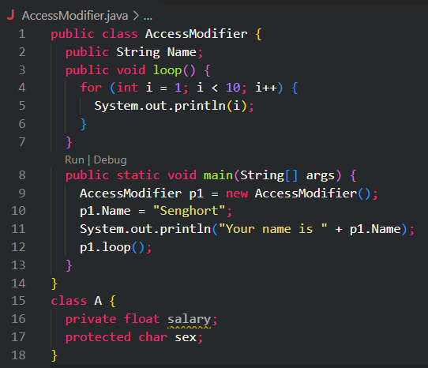
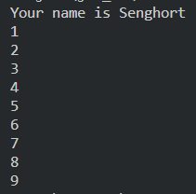
Public Modifier

Slide 8
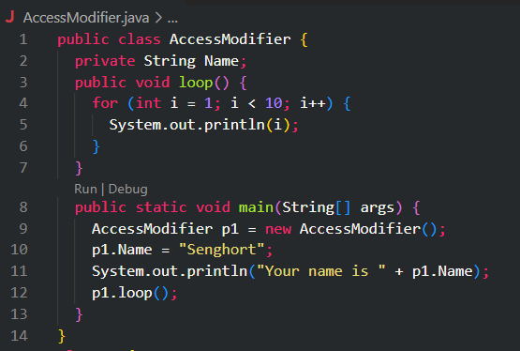
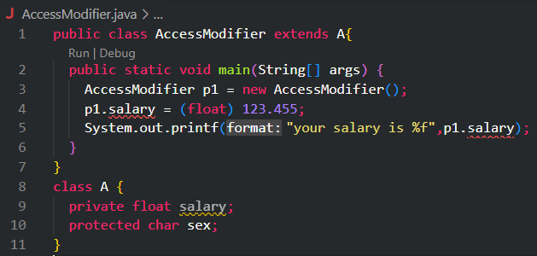

Private

Slide 9
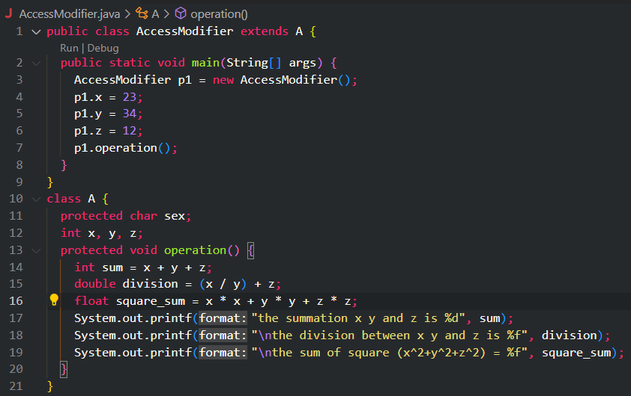

Protected

Slide 10
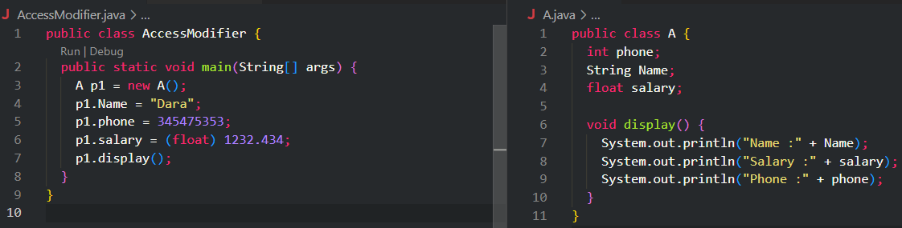

Default

Slide 11
02
Java – Non-Access Modifier

Slide 12
Non-Access Modifiers
Static
Final
Abstract
Synchronized
Volatile
Transient
The member belongs to the class, not the object of that class.
Value can’t be changed once assigned, methods can’t be overridden and classes can’t be inherited.
If applied to a method, has to be implemented in a subclass, if applied to a class must contains abstract methods.
Controls thread access to a block/method.
The variable value is always read from the main memory, not from a specific thread memory.
The member is skipped when serializing an object.

Slide 13
Code Implementation

Slide 14
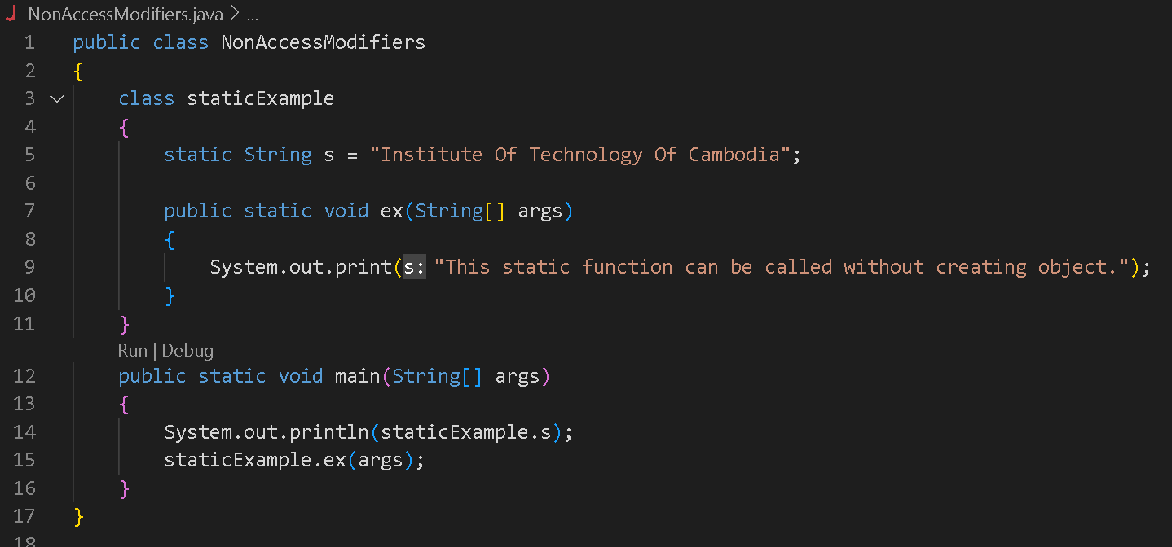
Static Modifier
Output:

Slide 15
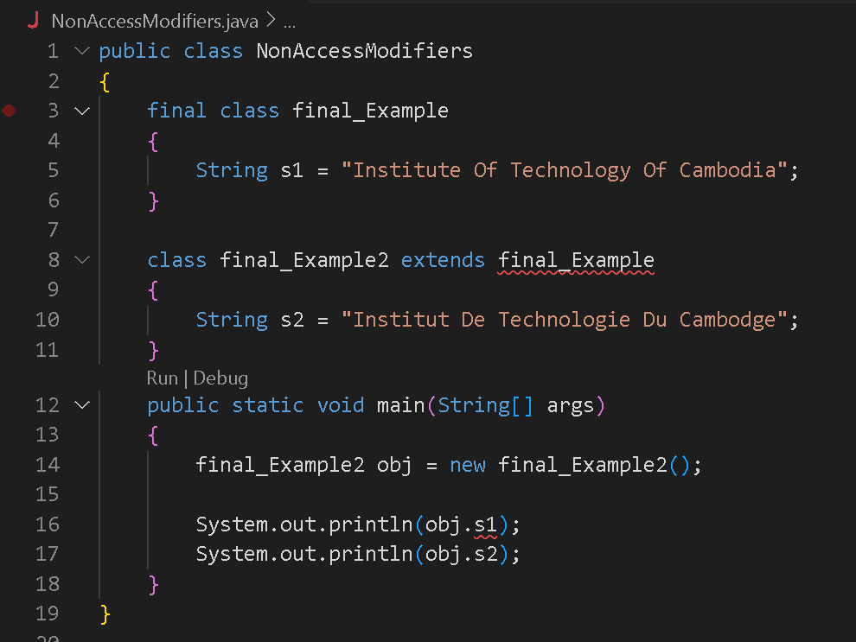
Final Modifier
Output:

Slide 16
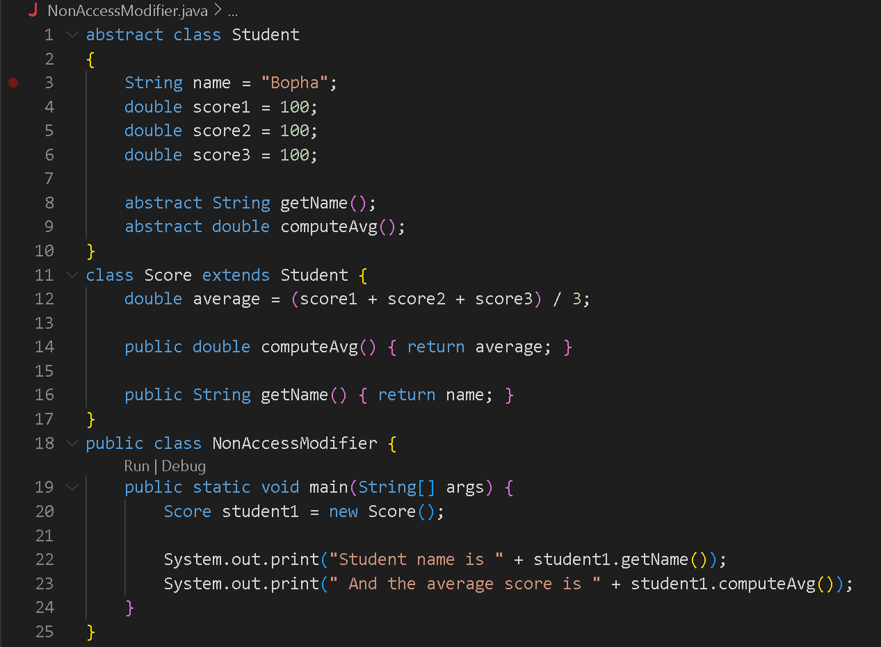
Abstract Modifier
Output:

Slide 17
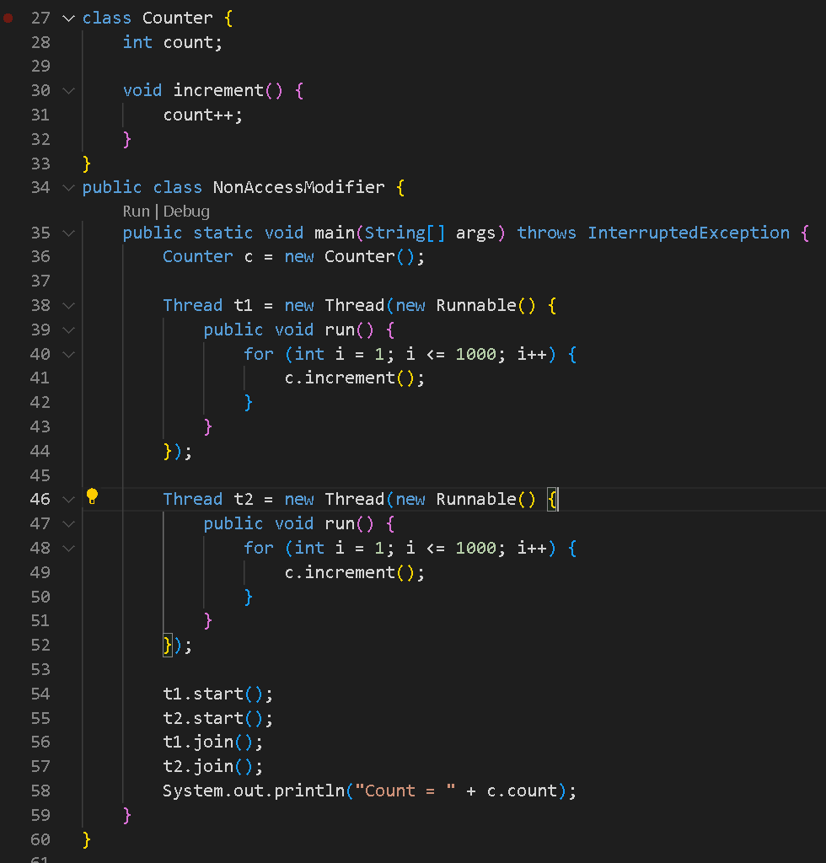
Non-Synchronize
Output:

Slide 18
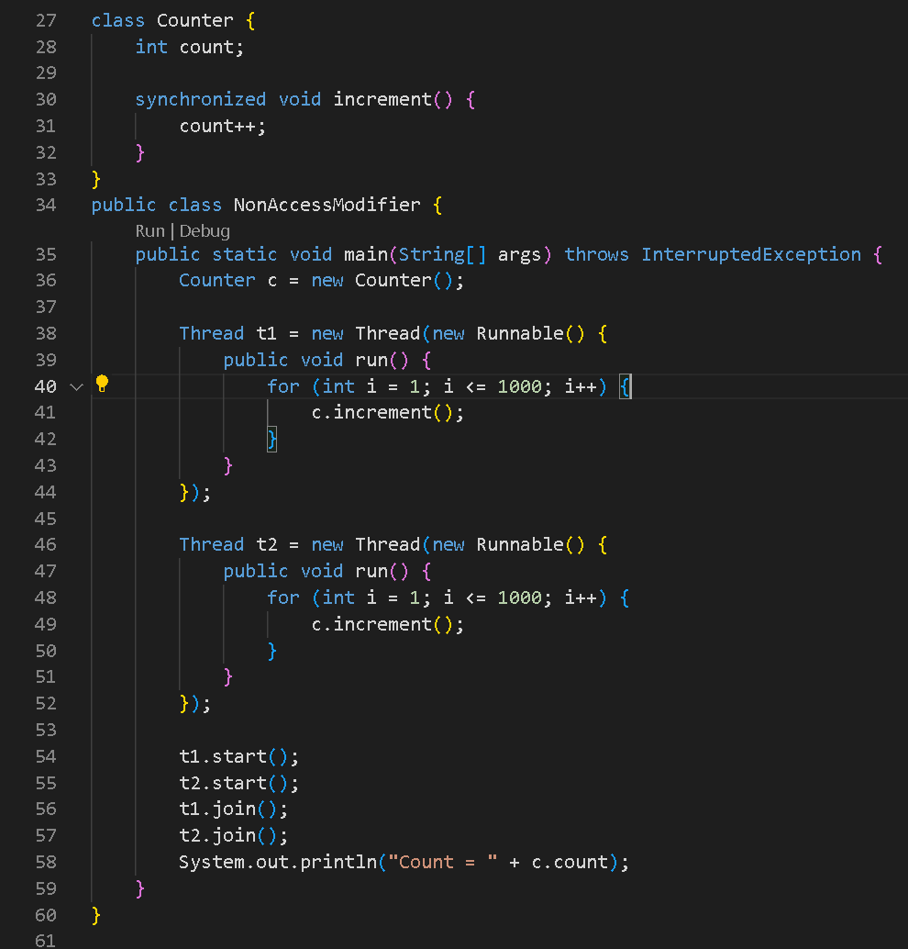
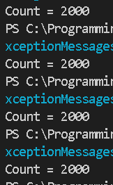
Synchronize
Output:

Slide 19




Volatile
Thread 1
Cache
Main Memory
Cache
Thread 2

Slide 20
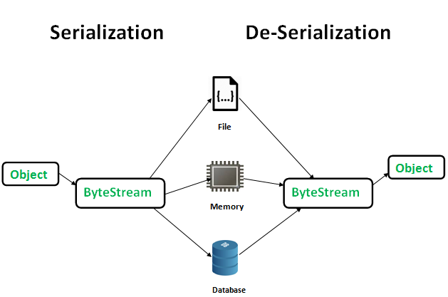
Transient

Slide 21
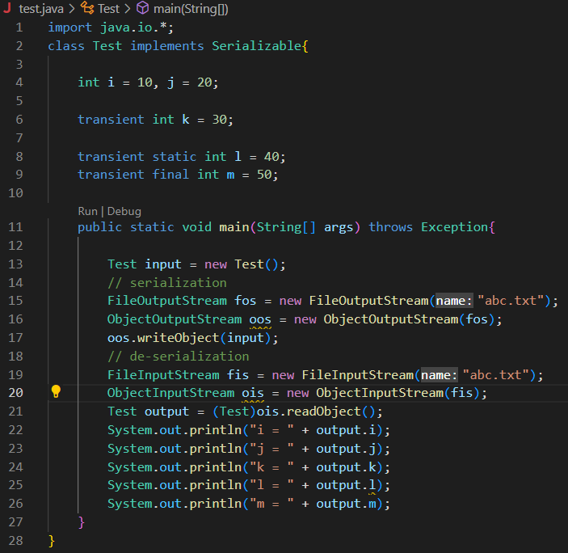

Transient
Output:

Slide 22
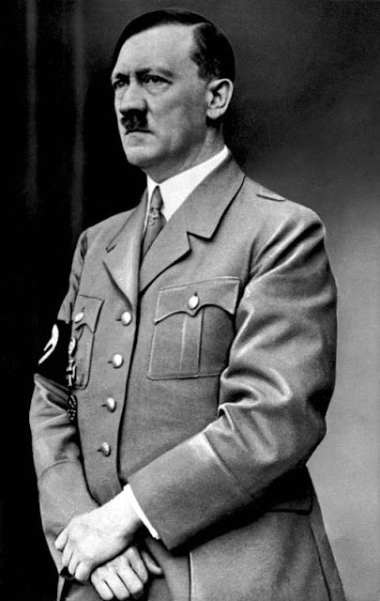
“If you have any questions, please keep it yourself, it’s not like we are god who can answered all of your questions”-Adolf Hitler

